Slide 1
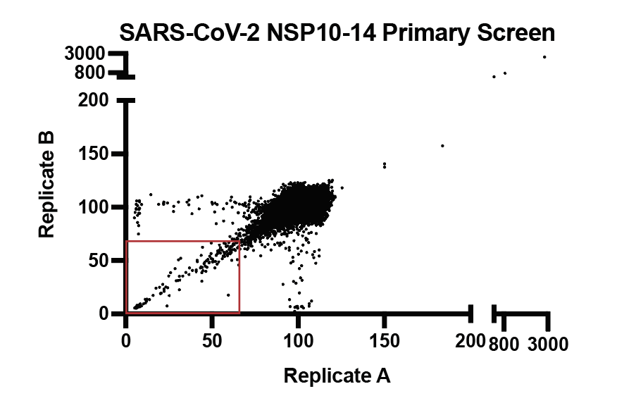
146 drug hits from 50K compounds primary screen
Pink highlighted = 46 drugs tested in Vero cells
Orange highlighted = 3 MedChem drugs

Slide 2
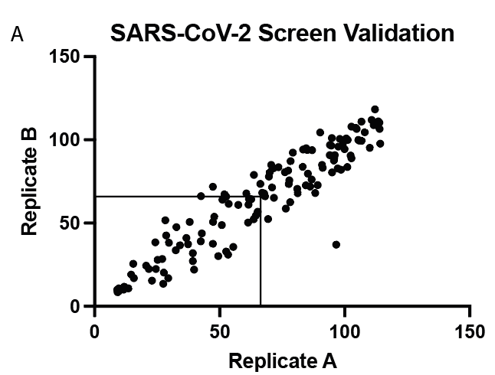
69 drugs (out of the initial 146) were revalidated (FRET screen)

Slide 3
Best MERS inhibition is 33%

Slide 4
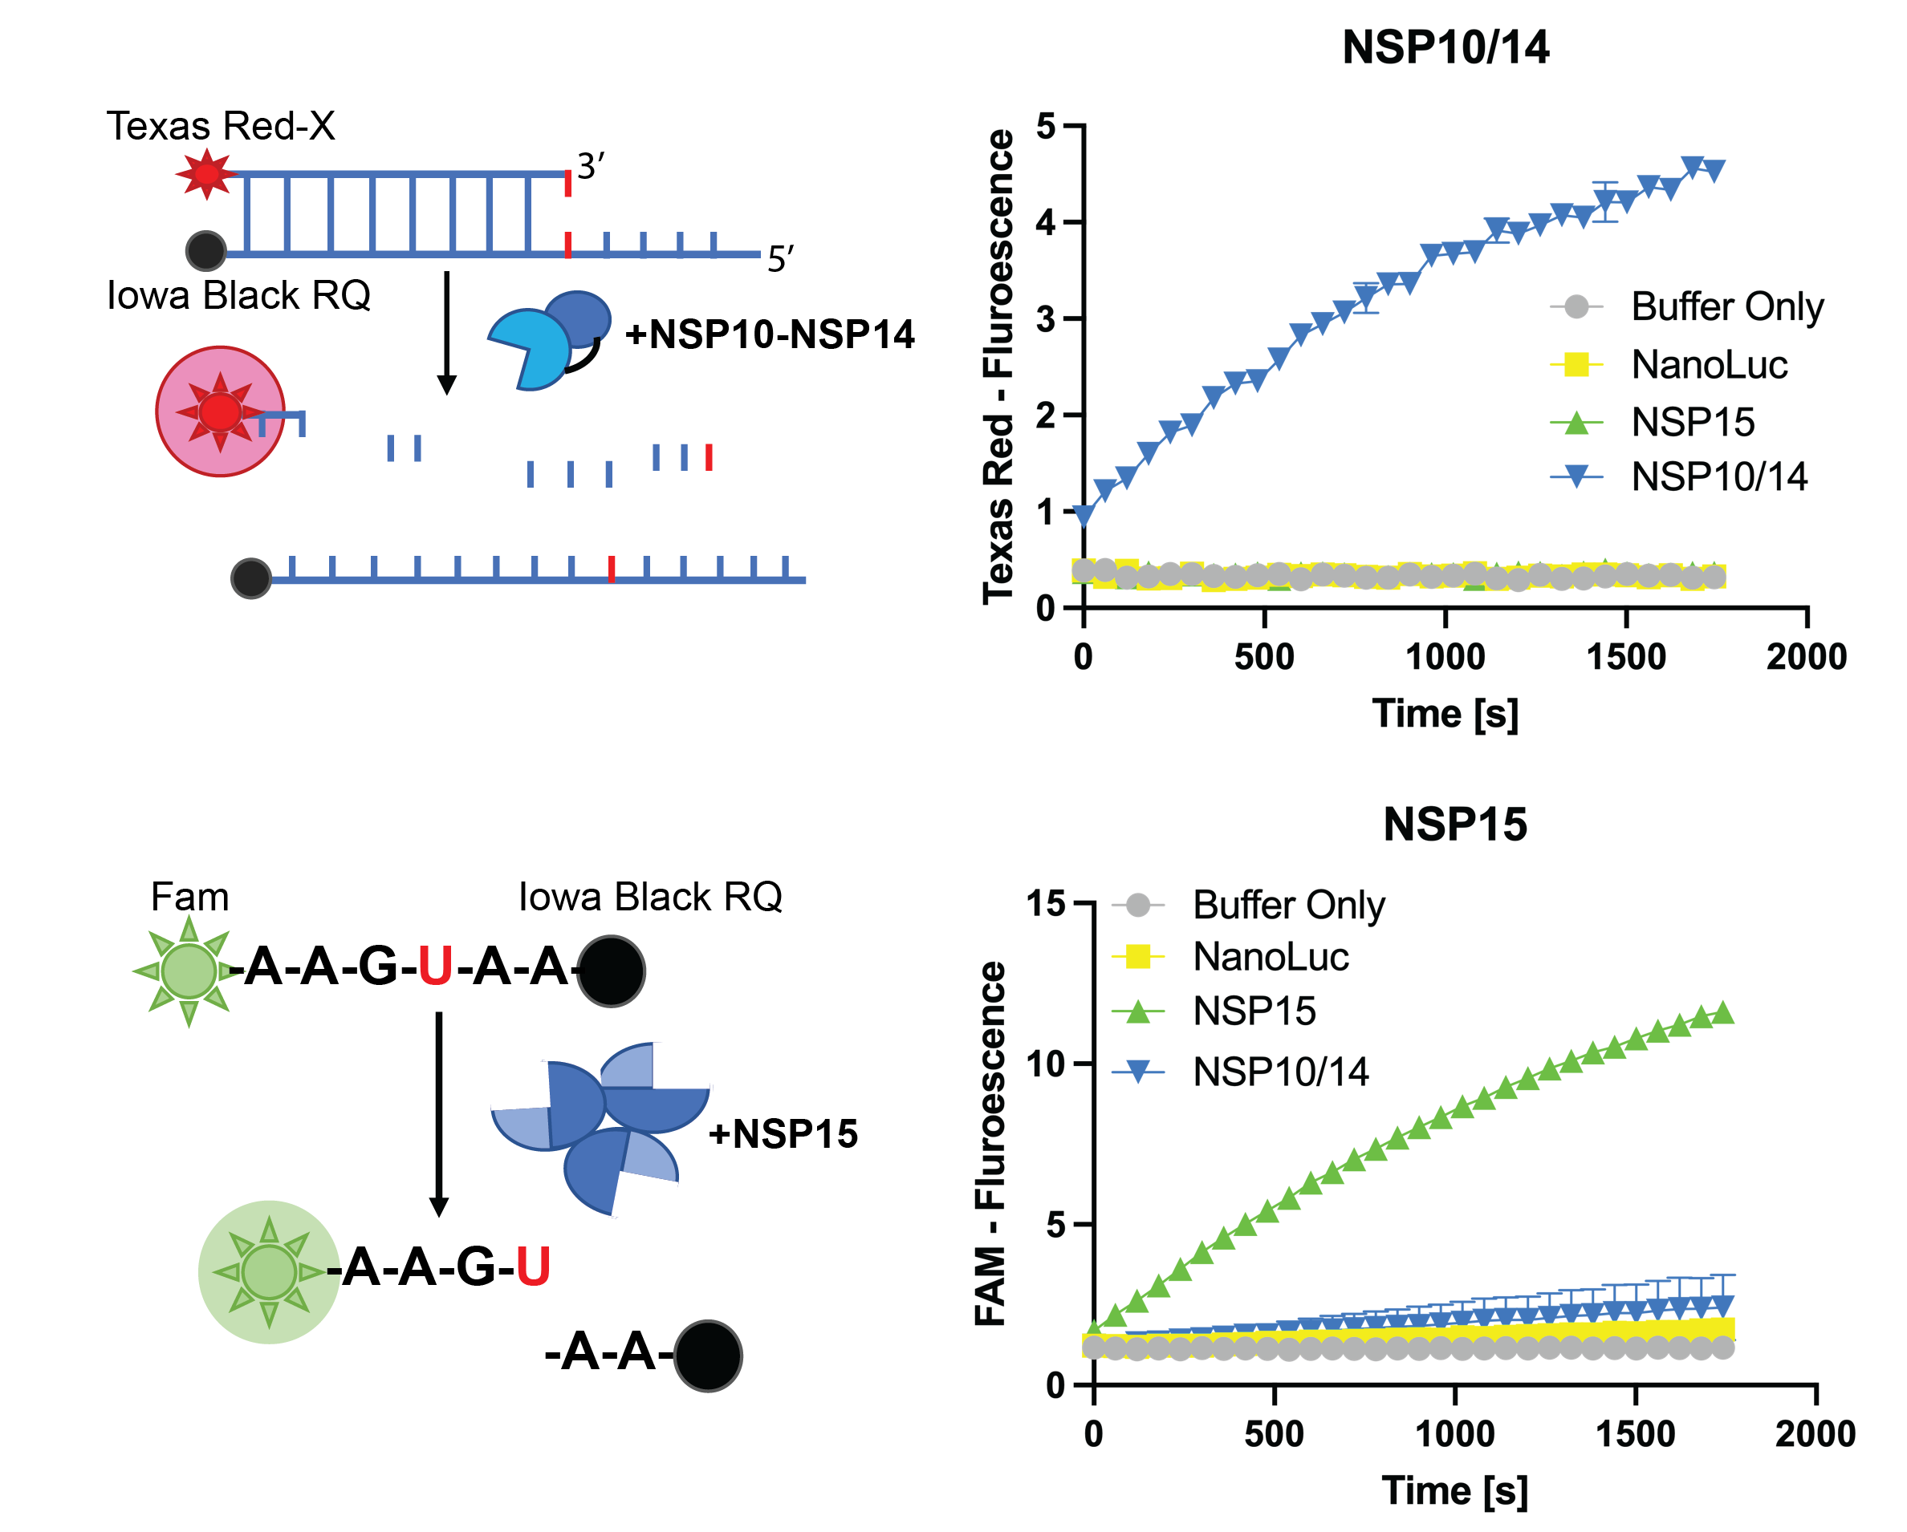
Some of the top hits from the screen were selected for derivatization
159-P9
RA-0020084-01
145-N15
RA-0020083-01
+ Mg²⁺
+ BSA
59-O9
RA-0020081-01

Slide 5
We observed limited activity in antiviral testing on A549 cells, however. Based on NSP14 mutant virus experiments in the Dennison lab, we tested the 69 validated on Vero cells as per their conditions.

Slide 6
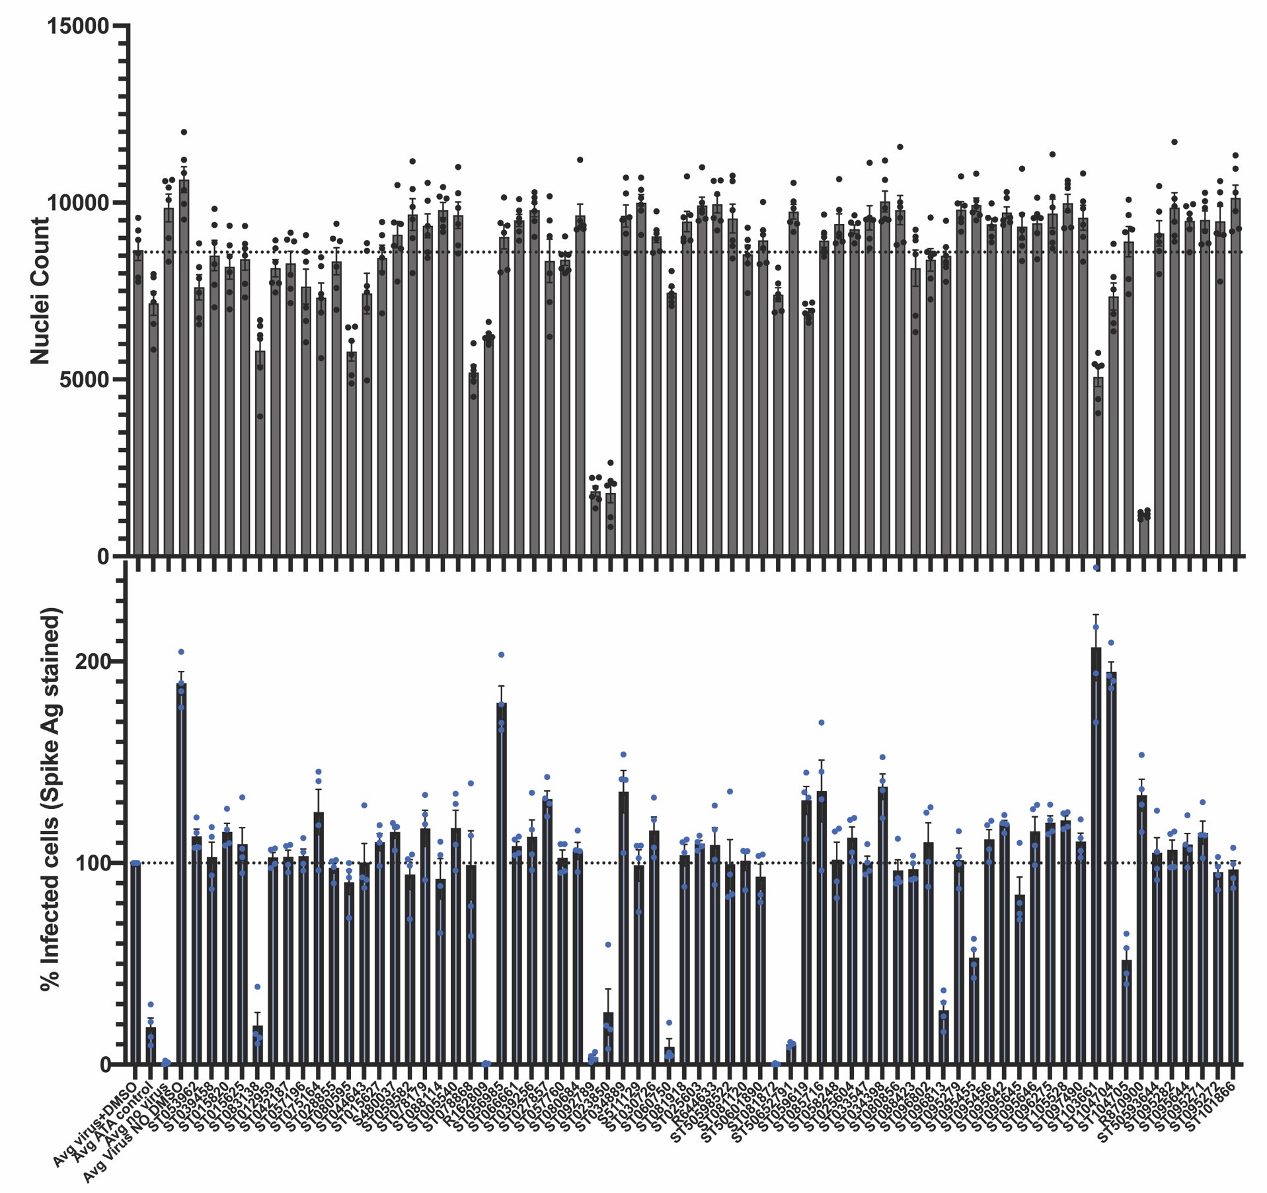
Viral inhibition and toxicity on Veros
Toxicity
Viral Replication

Slide 7
3 MedChem drugs: 1/3 have antiviral activity= ST095455

Slide 8
IC50 for our “star” MedChem drug ST095455
159-P9
RA-0020084-01

Slide 9
Next Steps
Test drugs with NSP14 mutant virus
Continue testing analogues

